Slide 1

Epic Games Store
Exclusive Games Selection Model
Notes:
Restart Timer [Next Slide]

Slide 2
Epic Games Store
Exclusive Games Selection Model
Notes:
Hello everyone, welcome to today’s meeting. This is a follow up on how we can use classification models to select exclusive games for our Store.

Slide 3

Motivation
Aggressive Pursuit is Unsustainable
Notes:
Remember from last meeting, the reason we need to better select our games is because our aggressive pursuit model, where we have spent billions of dollars in acquiring exclusives, is unsustainable. So today we will be exploring how classification models can help us do that.

Slide 4
Methodology
Data Ingestion
Steam Store API
Steam Spy API
Notes:
The first step is to collect our data. We will use the Steam Store and Steam Spy APIs to collect data for games on our competitor’s store.

Slide 5
Data
Target Variable:
Games played for >= 1 hour a day per player, for everyday the game has been available.
~1000 positive, 40000 negative
29 Feature Variables
Notes:
This data then allows us to formulate a target variable, that classifies whether a game is successful. We’ve decided that a game is positively classed if it has been played, on average, for at least 1 hour a day per player, for everyday that the game has been out.
This lead to 1000 positive observations to 40000 negative observations.
The data also provides us with 29 raw feature variables, which will allow us to model our target.

Slide 6
Methodology
Data Ingestion
Data Cleaning
Steam Store API
Steam Spy API
EDA
Remove Anomalies
Notes:
The Next step involved some data cleaning, which included removing anomalies such as idling games.

Slide 7
Methodology
Data Ingestion
Data Cleaning
Baselining
Steam Store API
Steam Spy API
EDA
Remove Anomalies
Metric Selection
Random Forest
Notes:
Next was to create a baseline model. Because our dataset is imbalanced, with the important positive class being the minority, recall and precision scores will be useful metrics. We must also consider that it costs us more to select a bad game compared to not selecting a good game. So an f0.6 score will be our main metric, weighing precision more heavily, while still accounting for recall. AUC will also be considered for comparing the predictive power of our models. Another consideration was whether we wanted an interpretable model. Because we only intend to use the model for game selection rather than game production, predictive performance was our priority.

Slide 8
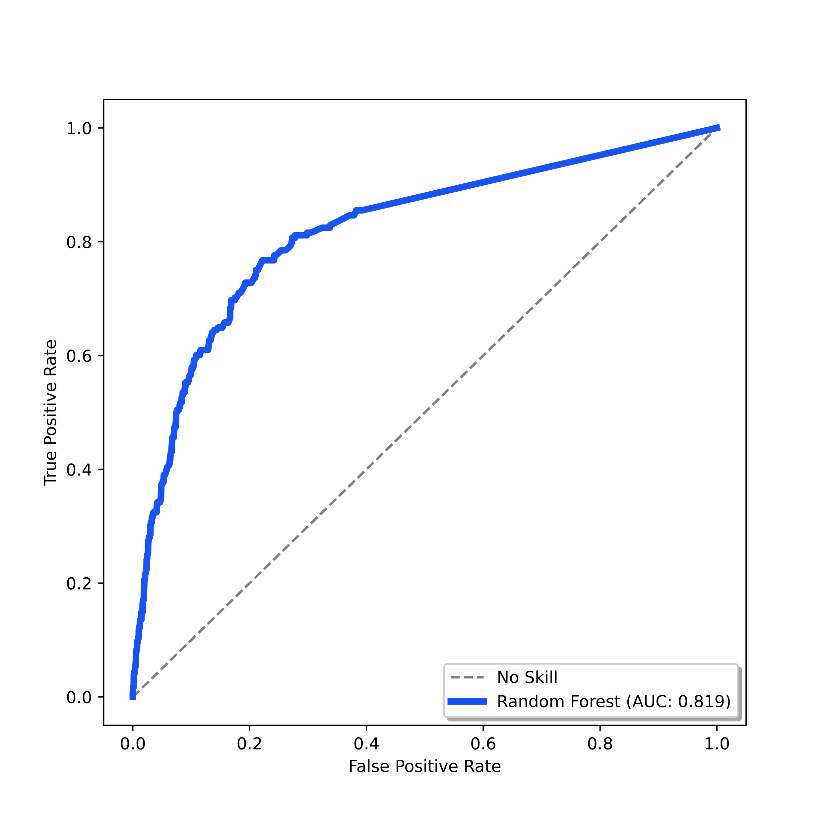
Baseline Model
Classifier:
Random Forest (200 estimators)
Features:
Genres, Categories, Platforms
Precision: 0.219
Recall: 0.135
F(0.6): 0.177
Notes:
Our baseline model used the random forest classifier with 200 estimators, using 3 multi category features. The features were genres, categories, and platforms.
This model was certainly better than nothing as can be seen with the ROC curve, however with a precision of 0.2, recall of .1 and thus an f0.6 of 0.177, it can certainly be improved.

Slide 9
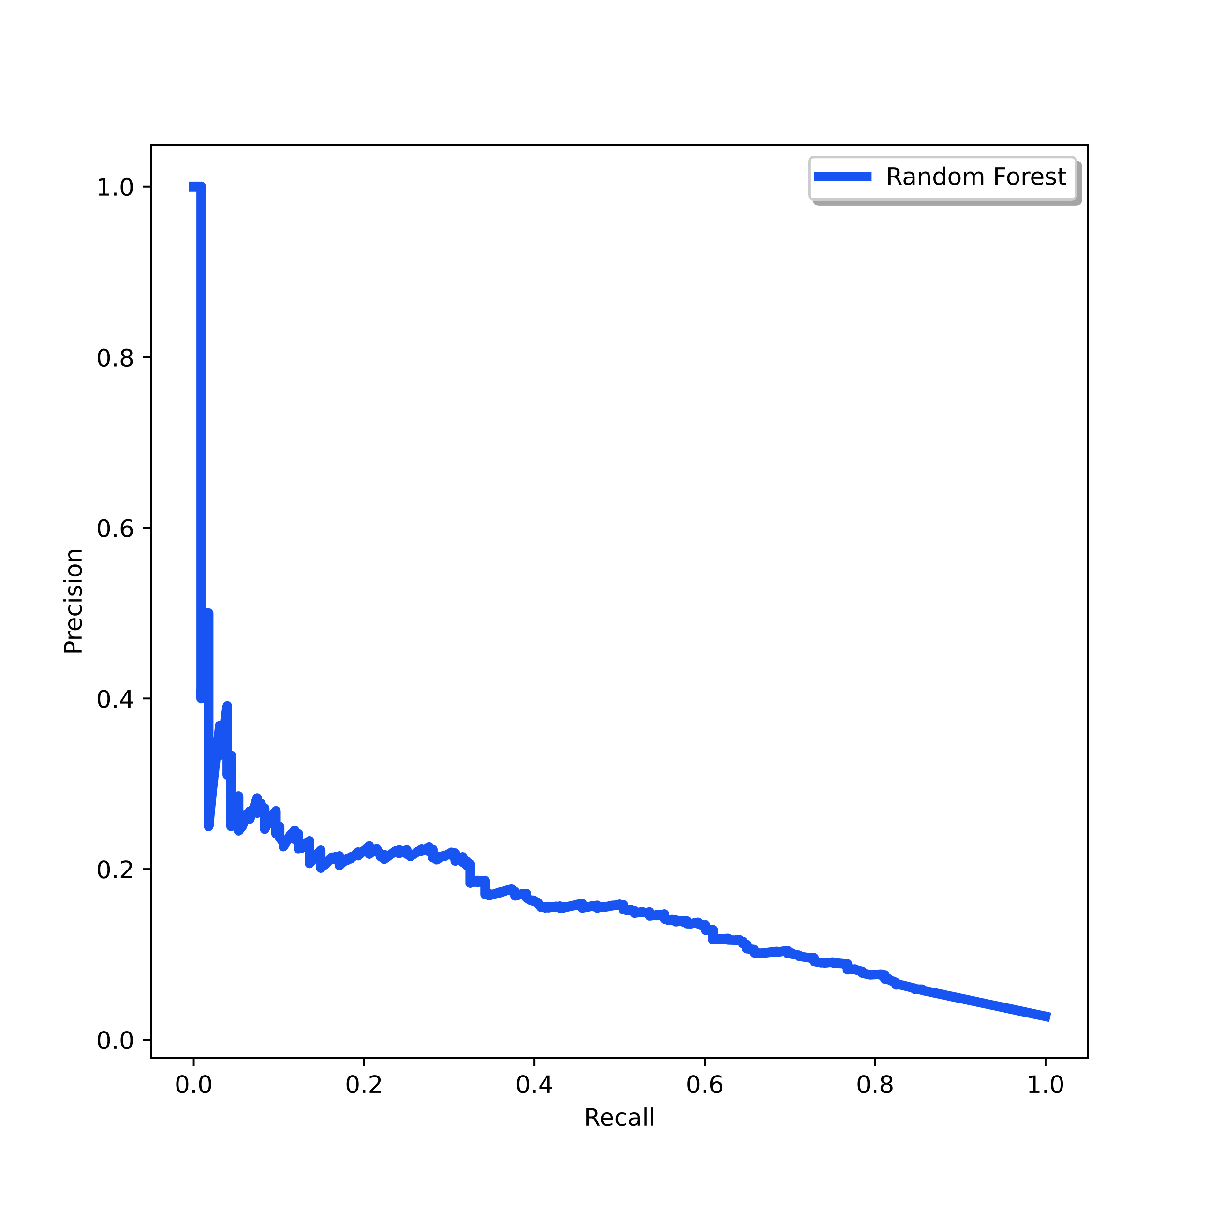
Baseline Model
Classifier:
Random Forest (200 estimators)
Features:
Genres, Categories, Platforms
Precision: 0.219
Recall: 0.135
F(0.6): 0.177
Notes:
We can also look at the precision and recall curve to see how our model performs with different thresholds. Again the model seems to perform poorly, with a terrible tradeoff of either low precision or low recall.

Slide 10
Train-Test Split
StratifiedSplit
Modelling Pipeline
Cross Validator
StratifiedKFold
GridSearchCV
Pre-processor
ColumnTransformer
SimpleImputer
MultiHotEncoder
Classifier
RandomForest
XGBoost
Notes:
So what was done to improve our model?
Firstly, pipelines were created in order to streamline the process of modelling and executing changes. This involved things like automatically processing our categorical variables or imputing missing values. Cross validation was also possible in the process, using stratifiedKfold to maintain the distribution of our target variable. Cross validation allowed us to make sure the model was not overfitting and led to better results for our test set.

Slide 11
Train-Test Split
StratifiedSplit
Modelling Pipeline
Explore other features
Tags
Cross Validator
StratifiedKFold
GridSearchCV
Pre-processor
ColumnTransformer
SimpleImputer
MultiHotEncoder
Classifier
RandomForest
XGBoost
Notes:
The first change was the implementation of other features in our dataset. Tags was the first to be implemented. There were 500 unique tags, and so while they could be simply encoded, some dimensionality reduction was also explored to see if it could improve the model. This involved adding an extra module into the preprocessor, for example PCA. These additions lead to slight improvements to our model.
It was important that when exploring features, data bleed was minimized as much as possible. Meaning only features that would realistically be available before prediction should be used.
This meant features like owners or hours could not be used directly, as there would be no way to know that before a game's release.

Slide 12
Train-Test Split
StratifiedSplit
Modelling Pipeline
Explore other features
Tags
Feature engineering
Historical Records Only
Producer Owners, Hours…
Cross Validator
StratifiedKFold
GridSearchCV
Pre-processor
ColumnTransformer
SimpleImputer
MultiHotEncoder
Classifier
RandomForest
XGBoost
Notes:
They were however engineered, so that any given game would have their producers’ average owners, or hours, for historical records only. This was engineered by using the release dates of observations. These engineered features also provided some improvements to our model.

Slide 13
Train-Test Split
StratifiedSplit
Modelling Pipeline
Explore other features
Tags
Feature engineering
Historical Records Only
Producer Owners, Hours…
Explore other models
XGBoost
Parameter tuning
Class weights
GridSearchCV
Cross Validator
StratifiedKFold
GridSearchCV
Pre-processor
ColumnTransformer
SimpleImputer
MultiHotEncoder
Classifier
RandomForest
XGBoost
Notes:
Next was to explore other models. The use of XGBoost lead to significant improvements in our scores.
This was accompanied with parameter tuning through GridSearch. This allowed for the best hyperparameter values to be used with regards to f0.6. Namely the selection of class weights and evaluation metrics with which to fit the model, were the most valuable hyperparameters.

Slide 14
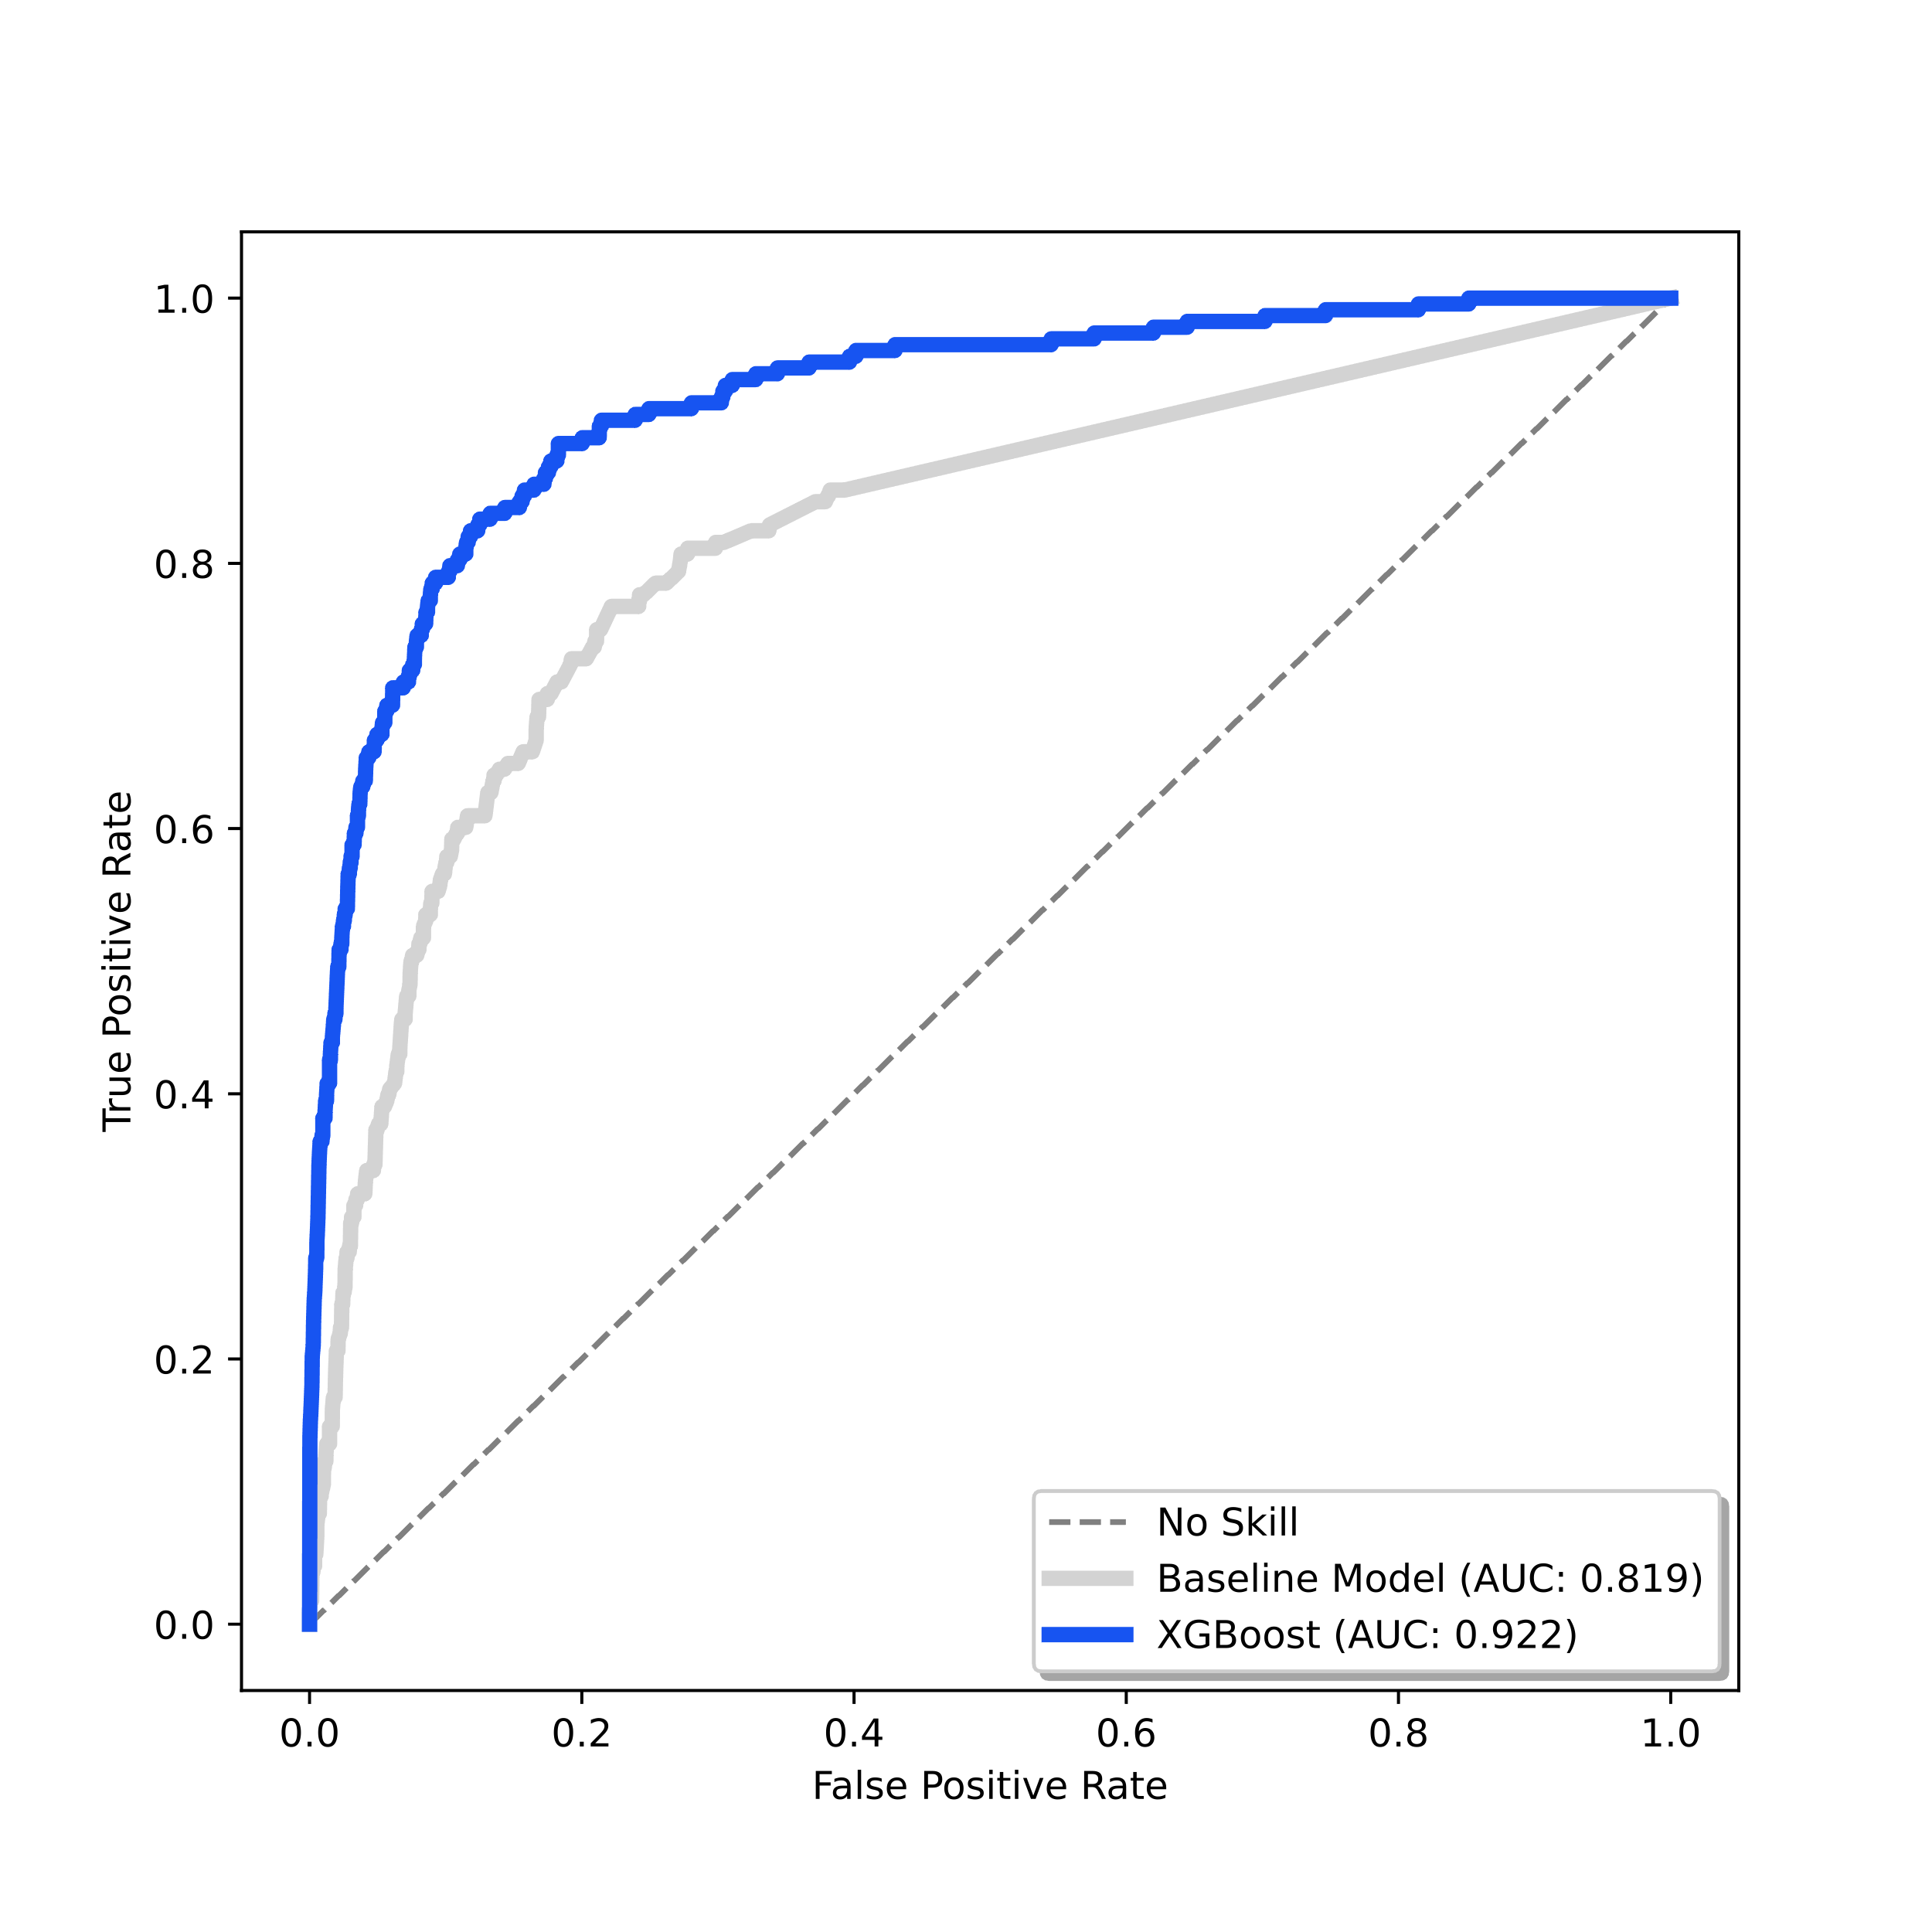
Final Model
Classifier:
XGBoost
500 estimators, class weight=10,
evaluation metric=’auc’
Features:
Tags, Genres, Categories, Platforms,
Historic Publisher Owners, Historic Publisher Hours, Supported Languages …
Precision: 0.400
Recall: 0.478
F(0.6): 0.436
Notes:
All those changes lead to a significant improvement in our model. Our latest model used XGBoost with 500 estimators, the use of class weights, the evaluation metric of auc and many other tuned parameters.
The model uses the engineered features mentioned previously along with other added features like supported languages.
As is illustrated in our roc curve, we have significantly improved auc compared to our baseline.
however, The model is still far from perfect as can be seen in our precision and f0.6 scores

Slide 15
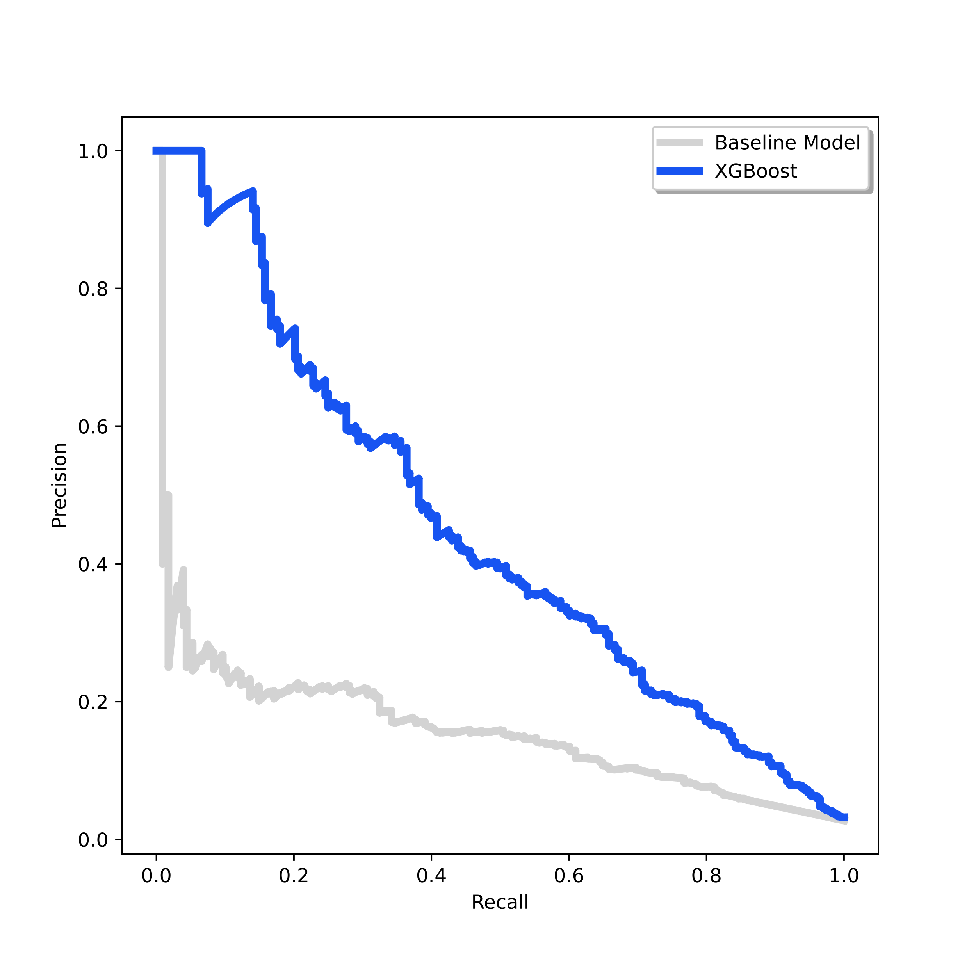
Final Model
Classifier:
XGBoost
500 estimators, class weight=10,
evaluation metric=’auc’
Features:
Tags, Genres, Categories, Platforms,
Historic Publisher Owners, Historic Publisher Hours, Supported Languages …
Precision: 0.400
Recall: 0.478
F(0.6): 0.436
Notes:
And looking at the pr curve again, we can also see that the tradeoff between precision and recall is more balanced than our baseline. With this in mind we can always adjust the decision threshold to account for better precision if we decide it to be more important in the future.

Slide 16
Conclusions and Future Work
There is potential for a classification model to select games
The limiting factor in this exploration was the data available
Collect time-series data
Explore other datasets/ data sources
Notes:
Finally, we can say that there is certainly potential for a classification model of good games. Based on the current investigation that has been done so far, I would say the limiting factor has been the dataset that was used. While more feature engineering could be done with the current dataset, we are limited to what we can engineer. There are also too many features that aren’t precise enough, and observations that are inaccurate. Time-series data for these features could possibly allow for better feature engineering with less data bleed and potentially lead to better models. We can also explore other data sources, or create our own data, to get more accurate observations.

Slide 17

Thank you!
Notes:
Thank you all for listening, any questions?

